Slide 1
Cognitive Psychology
Name:
Institution:
Professor Name:

Slide 2

Learning – Latent learning
Latent learning is a form of learning that is not immediately expressed in an overt response.
It occurs without any obvious reinforcement of the behavior or associations that are learned.
Latent learning is not readily apparent to the researcher because it is not shown behaviorally until there is sufficient motivation.
This type of learning broke the constraints of behaviorism, which stated that processes must be directly observable and that learning was the direct consequence of conditioning to stimuli.

Slide 3
Learning – Latent learning
Latent learning also occurs in humans. Children may learn by watching the actions of their parents but only demonstrate it at a later date, when the learned material is needed.
For example, suppose that John’s dad drives him to school every day. In this way, John learns the route from his house to his school, but he’s never driven there himself, so he has not had a chance to demonstrate that he’s learned the way.
One morning John’s dad has to leave early for a meeting, so he can’t drive John to school. Instead, John follows the same route on his bike that his dad would have taken in the car.
This demonstrates latent learning. John had learned the route to school, but had no need to demonstrate this knowledge earlier.

Slide 4
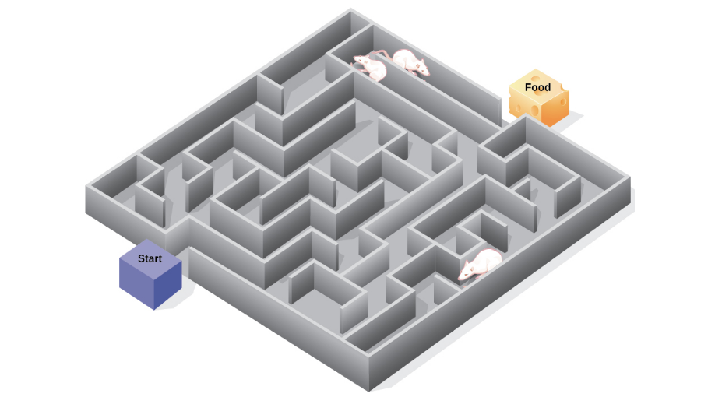
Learning – Latent learning
Latent learning demonstrated by ratsAs the unreinforced rats explored the maze, they developed a cognitive map: a mental picture of the layout of the maze and after 10 sessions in the maze without reinforcement, food was placed in a goal box at the end of the maze. As soon as the rats became aware of the food, they were able to find their way through the maze quickly, just as quickly as the comparison group, which had been rewarded with food all along.

Slide 5
Memory – Childhood amnesia
Childhood amnesia is a paucity of a certain type of memory known as autobiographical memory.
Autobiographical memories relate to events that happened to one’s self; events in which one participated; and about which one had emotions, thoughts, reactions, and reflections.
From a theoretical standpoint, childhood amnesia is interesting and important because of its implications for one’s sense of self.
Although we consider ourselves as continuous in space and time, there is a point in development at which that continuity ends.
That moment in time is the boundary of childhood amnesia. Childhood amnesia thus presents itself as apparent evidence of discontinuity in development.

Slide 6
Memory – Childhood amnesia
The most widely used method for testing childhood amnesia is the cue word technique. First developed by Sir Francis Galton in his early research on memory, the technique involves giving participants certain words such as; dog, cat, or chair and then asking them to "think of a specific memory" associated with that word as well as estimate their age at the time when they experienced that memory.
Cue word methods are often used to test autobiographical memory across the entire lifespan.
By comparing recall at different ages, memory researchers have identified the rate of normal forgetting that occurs for memories developed from the age of eight onward. From that point on, amnesia for early childhood events becomes well established with little change over time.
Various explanations have been offered, including Freud's theory that childhood amnesia is caused by repression of traumatic memories occurring in the child's early psychosexual development.

Slide 7
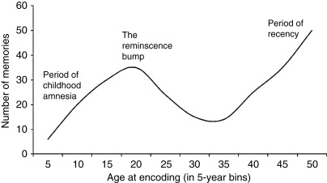
Memory – Childhood amnesia

Slide 8
Attention – Late filtering theory
Attention is the behavioral and cognitive process of selectively concentrating on a discrete stimulus while ignoring other perceivable stimuli.
It is a major area of investigation within education, psychology, and neuroscience. Attention can be thought of as the allocation of limited processing resources: your brain can only devote attention to a limited number of stimuli. Attention comes into play in many psychological topics, including memory, vision, and cognitive load.
Deutsch and Deutsch developed a model in which the location of the filter is even later. They suggested that stimuli are filtered out only after they have been analyzed for both their physical properties and their meaning. This later filtering would allow people to recognize information entering the unattended ear. Note that proponents of both the early and the late-filtering mechanisms propose that there is an attentional bottleneck through which only a single source of information can pass. The two models differ only in terms of where they hypothesize the bottleneck to be positioned.

Slide 9
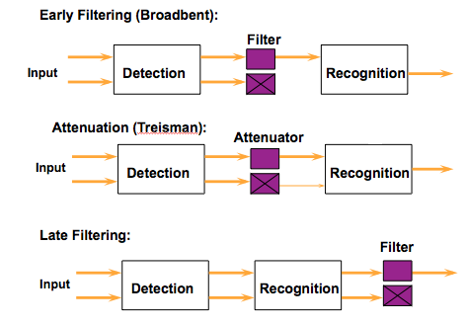
Attention – Late filtering theory

Slide 10
Perception – The Gestalt approach
The human brain is wired to see structure, logic, and patterns. It helps us make sense of the world. In the 1920s a group of German psychologists developed theories around how people perceive the world around them, called Gestalt principles. When this cognitive process kicks in, our minds leap from comprehending all of the elements as individual and unrelated components to seeing the entire shape as a whole. And as a result, we perceive forms and objects where none were created.

Slide 11
Perception – The Gestalt approach
The fundamental law that governs a Gestalt principle is that we tend to order our experience in a manner that’s regular, orderly, and recognizable. This is what allows us to create meaning in a complex and chaotic world. And having a solid understanding of how these principles work will help in the three ways.
Help determine which design elements are most effective in a given situation. For example, when to use visual hierarchy, background shading, gradients, and how to group similar items and distinguish different ones.
These psychological principles hold power to influence visual perception, which allows designers to direct attention to specific points of focus, get to take specific actions, and create behavioral change.
And finally, at the highest level, the Gestalt principles help in designing products that solve the customer’s problem or meet the user’s need in a way that’s beautiful, pleasing, and intuitive to use.

Slide 12
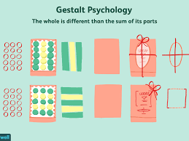
Perception – The Gestalt approach

Slide 13
Reference
Neisser, U. (2014). Cognitive psychology: Classic edition. Psychology Press.
Eysenck, M. W., & Keane, M. T. (2020). Cognitive psychology: A student’s handbook. Psychology press.
Sanborn, F. W., & Harris, R. J. (2019). A cognitive psychology of mass communication. Routledge.
Gallace, A., & Spence, C. (2020). A memory for touch: the cognitive psychology of tactile memory. In Touch in Museums (pp. 163-186). Routledge.
Shin, H. S. (2019). Reasoning processes in clinical reasoning: from the perspective of cognitive psychology. Korean journal of medical education, 31(4), 299.

